Slide 1


Problem-solving: Flowchart Design
CSC 102 – Problem Solving
Ekenedirichukwu .M. Akabogu

Slide 2

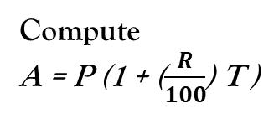
Flowchart To Calculate Simple Interest
START
Compute
A = P (1 + ($\frac{R}{100}$) T )
Input P, R, T
STOP
Print A

Slide 3

Flowchart To Calculate Compound Interest
Compute
$${A=P (1+\frac{R}{n})}^{nt}$$
START
Input P, R, n, t
STOP
Print A

Slide 4

Flowchart To Calculate Annuity Plan
Compute
$$A=PMT ×\frac{[(1+\frac{R}{n})^{nt}−1] }{(\frac{R}{n})}$$
START
Input PMT, R, n, t
STOP
Print A

